Slide 1







Technology Trends
George Sylva
9/8/2023

Slide 2


OUTLINE
Executive Summary
Introduction
Methodology
Results
Visualization – Charts
Dashboard
Discussion
Findings & Implications
Conclusion
Appendix

Slide 3

EXECUTIVE SUMMARY
• Overview of summary from dashboard • Data Source • Demographics • Technologies • Current Technology Usage • Future Technology Trend • Demographics

Slide 4

INTRODUCTION
Demographics for technologies analysis.
To provide information on high level data trends.
Overview with information using dashboard.
Two aspects of analyzing:
Demographics
Technology

Slide 5

METHODOLOGY
Data from Stack Overflow:
m5_survey_data_technologies_normalised.csv for technology datapoints.
m5_survey_data_demographics.csv for demographic datapoints.
https://sa1.ca.analytics.ibm.com/bi/?perspective=dashboard&pathRef=.my_folders%2FM5_Survey%2Bdashboard&id=i955D2345DBE446A89AEEADCC92527840&objRef=i955D2345DBE446A89AEEADCC92527840&options%5BdisableGlassPrefetch%5D=true&options%5Bcollections%5D%5BcanvasExtension%5D%5Bid%5D=com.ibm.bi.dashboard.canvasExtension&options%5Bcollections%5D%5BfeatureExtension%5D%5Bid%5D=com.ibm.bi.dashboard.core-features&options%5Bcollections%5D%5Bbuttons%5D%5Bid%5D=com.ibm.bi.dashboard.buttons&options%5Bcollections%5D%5Bwidget%5D%5Bid%5D=com.ibm.bi.dashboard.widgets&options%5Bcollections%5D%5BcontentFeatureExtension%5D%5Bid%5D=com.ibm.bi.dashboard.content-features&options%5Bcollections%5D%5BsaveServices%5D%5Bid%5D=com.ibm.bi.dashboard.saveServices&options%5Bcollections%5D%5Btemplates%5D%5Bid%5D=com.ibm.bi.dashboard.templates&options%5Bcollections%5D%5BvisualizationExtension%5D%5Bid%5D=com.ibm.bi.dashboard.visualizationExtensionCA&options%5Bcollections%5D%5BboardModel%5D%5Bid%5D=com.ibm.bi.dashboard.boardModelExtension&options%5Bcollections%5D%5BcontentTypes%5D%5Bid%5D=com.ibm.bi.dashboard.contentTypes&options%5Bcollections%5D%5BserviceExtension%5D%5Bid%5D=com.ibm.bi.dashboard.serviceExtension&options%5Bcollections%5D%5BlayoutExtension%5D%5Bid%5D=com.ibm.bi.dashboard.layoutExtension&options%5Bcollections%5D%5BcolorSetExtensions%5D%5Bid%5D=com.ibm.bi.dashboard.colorSetExtensions&options%5Bconfig%5D%5Bproduct%5D=CA&options%5Bconfig%5D%5BeditPropertiesLabel%5D=true&options%5Bconfig%5D%5BenableCustomVisualizations%5D=true&options%5Bconfig%5D%5BassetTags%5D%5B%5D=dashboard&options%5Bconfig%5D%5BfilterDock%5D=true&options%5Bconfig%5D%5BshowMembers%5D=true&options%5Bconfig%5D%5Bupgrades%5D=dashboard-core%2Fjs%2Fdashboard%2Fupgrades&options%5Bconfig%5D%5BassetType%5D=exploration&options%5Bconfig%5D%5BgeoService%5D=CA&options%5Bconfig%5D%5BsmartTitle%5D=true&options%5Bconfig%5D%5BnavigationGroupAction%5D=true&options%5Bconfig%5D%5BenableDataQuality%5D=false&options%5Bconfig%5D%5BmemberCalculation%5D=false&subView=model00000189dcf3120c_00000000&isAuthoringMode=false&boardId=i955D2345DBE446A89AEEADCC92527840Webscraping Stack Overflow collected for datapoints
Gathering and cleaning data
Error tracking
Analyzed through Cognos Visualization tools

Slide 6
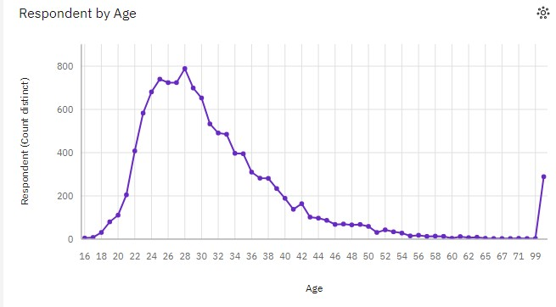
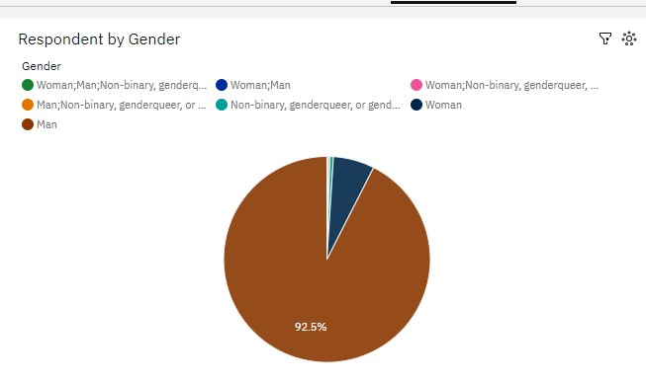
RESULTS

Slide 7
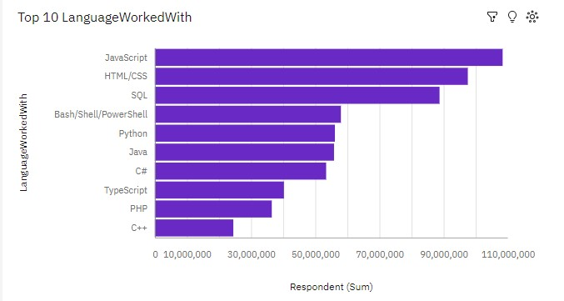
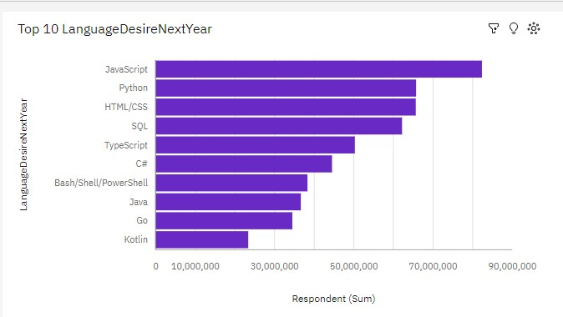
PROGRAMMING LANGUAGE
Current Year
Next Year

Slide 8
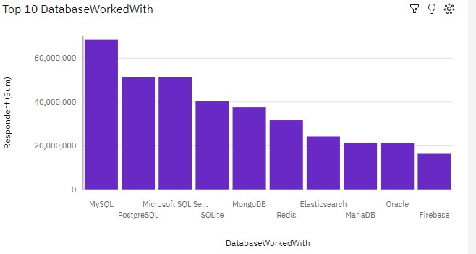
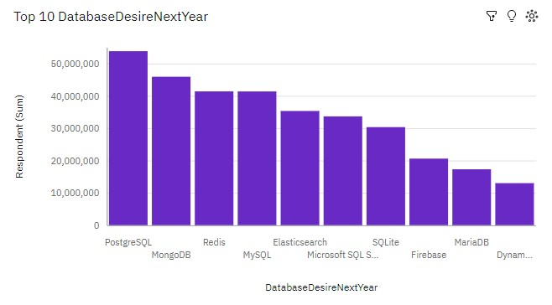
DATABASE TRENDS
Current Year
Next Year

Slide 9
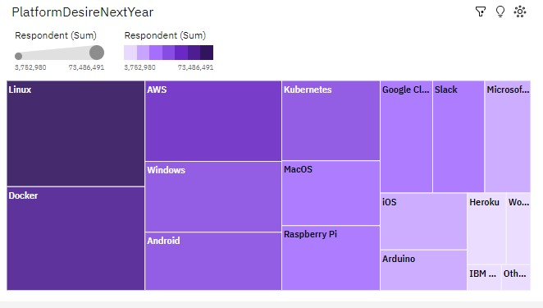
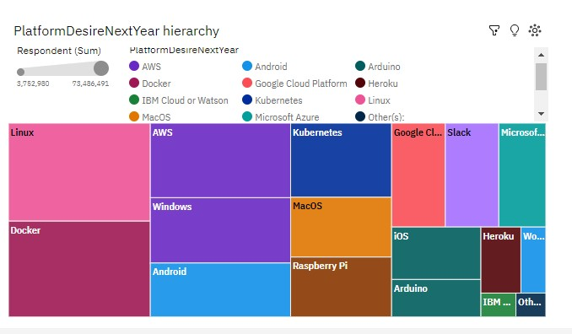
PLATFORM DESIRED

Slide 10
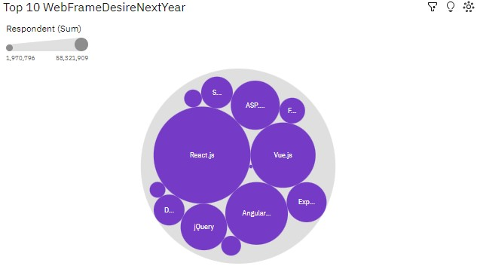
WEBFRAME PLOT

Slide 11
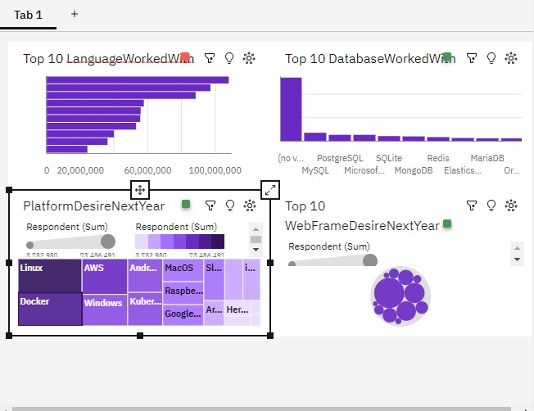
LANGUAGES WORKED WITH

Slide 12
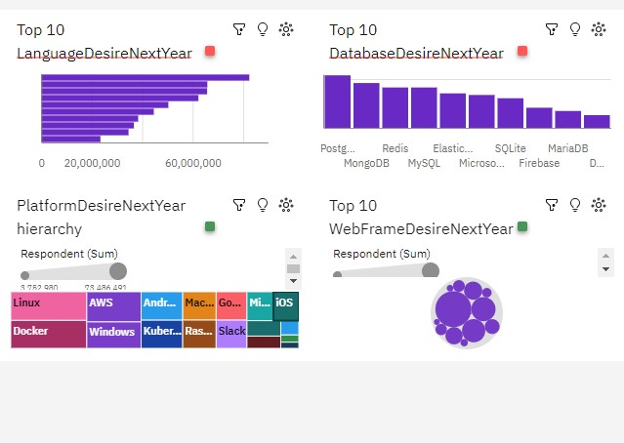
LANGUAGES DESIRED NEXTYEAR DASHBOARD

Slide 13
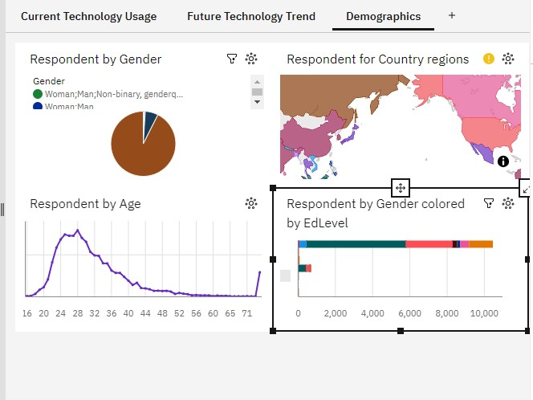
DEMOGRAPHIC DASHBOARD

Slide 14
PROGRAMMING LANGUAGE TRENDS - FINDINGS & IMPLICATIONS
Top 5 turnover in future language
Current Year top 5 are HTML/CSS, Bash, Javascript, Python, and SQL
Future Year top 5 are HTML/CSS, JavaScript, Python, SQL, TypeScript
Different Top 5 are Typescript
Implications
top language are still HTML/CSS
Javascript, SQL, and Python are still one of the most popular

Slide 15
DATABASE TRENDS - FINDINGS & IMPLICATIONS
Findings
MySQL is most popular DB of the year
PostgreSQL is most popular DB of next year
Both MS SQL Server and PostgrSQL are on the top 5
Redis had a large increase for future
Implications
Most people currently have skill of MySQL
PostgreSQL in coming year
PostgreSQL and MongoDB are both popular
Redis is new to the top 5

Slide 16

DASHBOARD
LINK:
https://sa1.ca.analytics.ibm.com/bi/?perspective=dashboard&pathRef=.my_folders%2FM5_Survey%2Bdashboard&id=i955D2345DBE446A89AEEADCC92527840&objRef=i955D2345DBE446A89AEEADCC92527840&options%5BdisableGlassPrefetch%5D=true&options%5Bcollections%5D%5BcanvasExtension%5D%5Bid%5D=com.ibm.bi.dashboard.canvasExtension&options%5Bcollections%5D%5BfeatureExtension%5D%5Bid%5D=com.ibm.bi.dashboard.core-features&options%5Bcollections%5D%5Bbuttons%5D%5Bid%5D=com.ibm.bi.dashboard.buttons&options%5Bcollections%5D%5Bwidget%5D%5Bid%5D=com.ibm.bi.dashboard.widgets&options%5Bcollections%5D%5BcontentFeatureExtension%5D%5Bid%5D=com.ibm.bi.dashboard.content-features&options%5Bcollections%5D%5BsaveServices%5D%5Bid%5D=com.ibm.bi.dashboard.saveServices&options%5Bcollections%5D%5Btemplates%5D%5Bid%5D=com.ibm.bi.dashboard.templates&options%5Bcollections%5D%5BvisualizationExtension%5D%5Bid%5D=com.ibm.bi.dashboard.visualizationExtensionCA&options%5Bcollections%5D%5BboardModel%5D%5Bid%5D=com.ibm.bi.dashboard.boardModelExtension&options%5Bcollections%5D%5BcontentTypes%5D%5Bid%5D=com.ibm.bi.dashboard.contentTypes&options%5Bcollections%5D%5BserviceExtension%5D%5Bid%5D=com.ibm.bi.dashboard.serviceExtension&options%5Bcollections%5D%5BlayoutExtension%5D%5Bid%5D=com.ibm.bi.dashboard.layoutExtension&options%5Bcollections%5D%5BcolorSetExtensions%5D%5Bid%5D=com.ibm.bi.dashboard.colorSetExtensions&options%5Bconfig%5D%5Bproduct%5D=CA&options%5Bconfig%5D%5BeditPropertiesLabel%5D=true&options%5Bconfig%5D%5BenableCustomVisualizations%5D=true&options%5Bconfig%5D%5BassetTags%5D%5B%5D=dashboard&options%5Bconfig%5D%5BfilterDock%5D=true&options%5Bconfig%5D%5BshowMembers%5D=true&options%5Bconfig%5D%5Bupgrades%5D=dashboard-core%2Fjs%2Fdashboard%2Fupgrades&options%5Bconfig%5D%5BassetType%5D=exploration&options%5Bconfig%5D%5BgeoService%5D=CA&options%5Bconfig%5D%5BsmartTitle%5D=true&options%5Bconfig%5D%5BnavigationGroupAction%5D=true&options%5Bconfig%5D%5BenableDataQuality%5D=false&options%5Bconfig%5D%5BmemberCalculation%5D=false&subView=model00000189dcf3120c_00000000&isAuthoringMode=false&boardId=i955D2345DBE446A89AEEADCC92527840

Slide 17
DISCUSSION
Javascript and HTML Remain Dominant Languages
PostgreSQL Database projected to overtake MySQL
Linux, Docker, and AWS largest 3 Future Platforms Desired
Large desirability to work with new technologies:
Redia moves into 3rd most wanted Database
PostgreSQL most wanted future Database, overtaking MySQL
Very large increase in desire for TypeScript language, breaking into top 5

Slide 18
OVERALL FINDINGS & IMPLICATIONS
Findings
Turnover in Languages namely Python and TypeScript
Turnover in DB’s namely Redia and PostgreSQL
Elasticsearch, Bash, and C# desirability drops
Implications
Javascript and HTML Remain Dominant Languages
Redia moves into top 5 (3rd place) and PostgreSQL now the number 1 most wanted DB
Drops off top 5 of respective categories

Slide 19

CONCLUSION
Language focus is shifting in favor of TypeScript: 26.49% increase is desire
Database focus is shifting in favor of PostgreSQL: 5.64% increase in desire
Overall Javascript and HTML still most dominant languages
Redia moves the most places for DB’s

